Slide 1

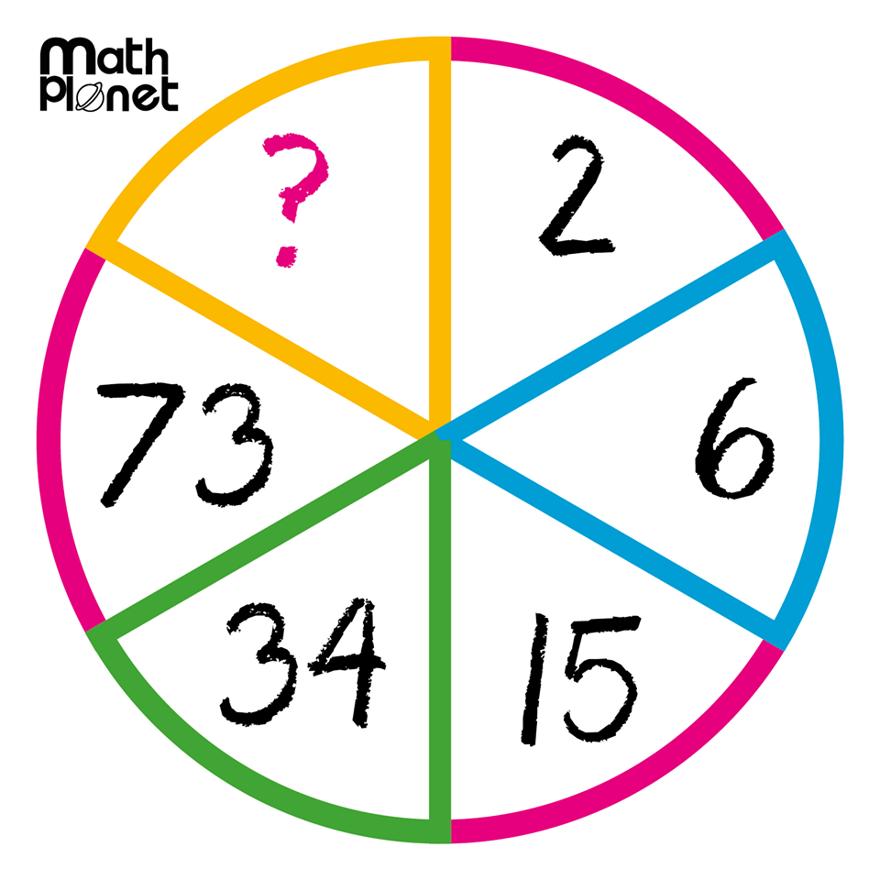
Today
Topic: Simple Interest Continued
EQ: How do you calculate simple interest with different units of time?
Mental warm up:
Chocolate for the first person to find the missing number

Slide 2
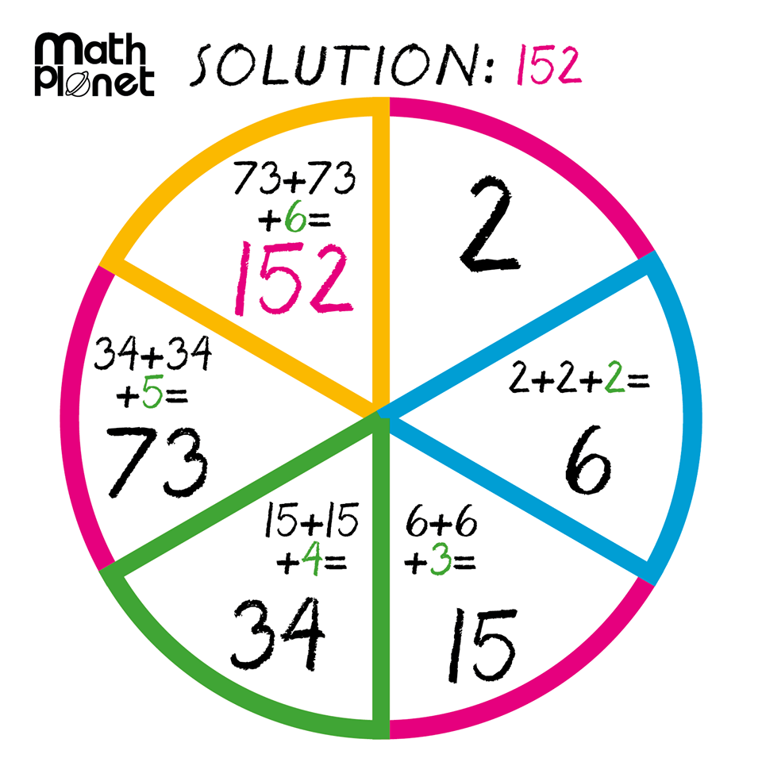

Slide 3

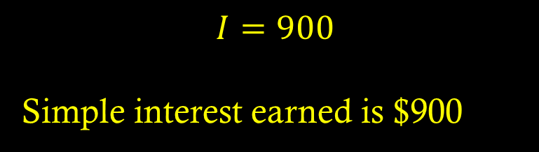
Warm up (Look at notes from last lesson if stuck)
P = $3,000
T=3
R = 10% convert to decimal →
Calculate simple interest
0.1
I = PRT
$$I=3000×0.1×3$$
$$I=900$$
Simple interest earned is $900

Slide 4
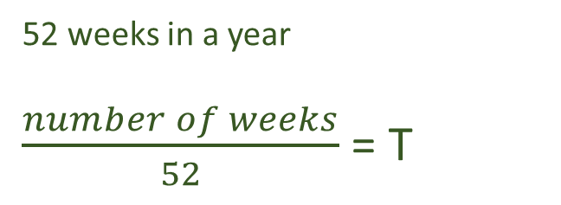
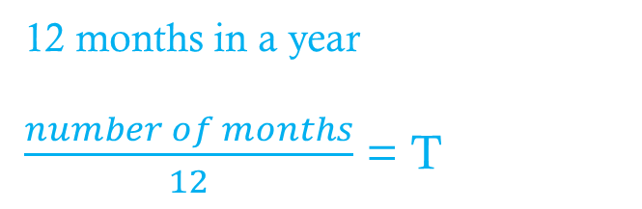
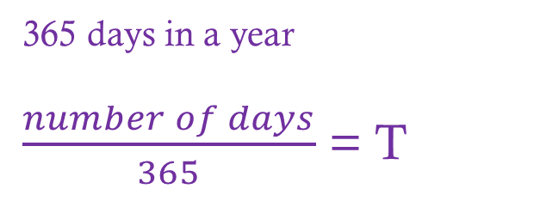
Topic: Simple Interest Continued
EQ: How do you calculate simple interest with different units of time?
I = PRT
REVISION
What unit is T?
12 months in a year
$\frac{number of months}{12}$ = T
YEARS
Conversion to Years
Moving ahead??
Convert these:
10 months =
22 weeks =
180 days =
Months
52 weeks in a year
$\frac{number of weeks}{52}$ = T
Weeks
365 days in a year
$\frac{number of days}{365}$ = T
Days

Slide 5
Let’s Try It Out
P = $2,500 and the interest rate is 12%
Find the simple interest (I)
 | 24 weeks | 18 months | 6 months | 250 days
T =
Working
I =

Slide 6
Fact Finder WS
Q1 and Q2 today we will use this worksheet again tomorrow

